Slide 1
ACCESS
SESSION 3

Slide 2
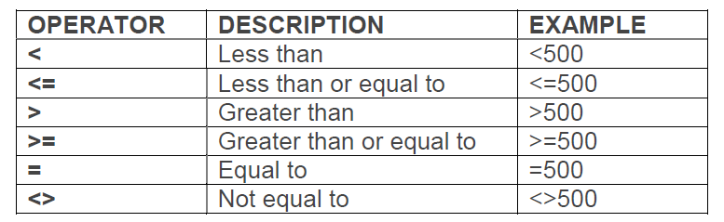
USING OPERATORS IN QUERIES
USING COMPARISON OPERATORS
An operator is a sign or symbol that specifies the type of calculation to perform within an expression. There are mathematical, comparison, logical, and reference operators.
Comparison operators are used for comparing values and return true or false depending upon the data in the table.

Slide 3
USING OPERATORS IN QUERIES
USING AN AND CONDITION
Logical operators (AND, OR, NOT) are used to combine two expressions and return a true, false, or null result. Logical operators are also referred to as Boolean operators.
The And operator returns True when both the expressions are true.
Example: Joining Date >= 1/1/2011 AND <= 31/12/2011. This query criteria will display all the details of those employees who joined in the year 2011.
USING AN OR CONDITION
The logical operators are used to combine more than one expression. The “Or” operator returns True when any one of the expressions returns true. The “Or” operator returns false when both the expressions returns false.
Example: Country=”USA” OR “UK”. This query criterion will display all the records where the country is either USA or UK.

Slide 4
USING OPERATORS IN QUERIES
USING A NOT CONDITION
The logical operators are used to combine more than one expression. The “Not” operator is used to exclude records in the query.
Example: Country<>”USA”. This query criterion will display all the records where the country is not USA.
USING THE BETWEEN…AND OPERATOR
The Between … And operator determines whether the value of an expression falls within a specified range of values or not.
For example: You can use Between 1000 And 2000 criteria in the Basic Salary field to display those records that falls within the range or not.

Slide 5
USING OPERATORS IN QUERIES
USING A WILDCARD CHARACTER
A wildcard is a special character that can represent any character that may appear in the same position in the field. Common wildcards include asterisk (*), the question mark (?), and the number sign (#).
* or % Matches any number of characters
? or _ Matches a single character in a specific position
# Matches a number
Note: The % and _ characters are only available when using the Microsoft Access database engine and the Microsoft Office Access 2007 OLE DB Provider

Slide 6
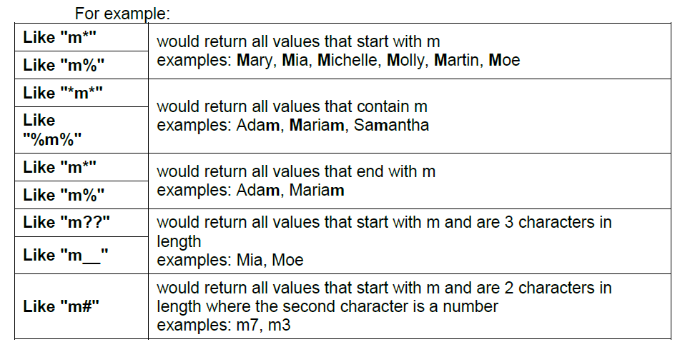
USING OPERATORS IN QUERIES

Slide 7
CREATING RELATIONSHIPS
USING RELATED TABLES
A relationship helps you combine data from two or more different tables. Each relationship consists of fields in two tables, with data that corresponds.
Tables can be joined, or related, in order to access and coordinate information in all the fields of the related tables. Joining tables is a useful way to avoid entering duplicate information in various, related tables.
A relationship is built by matching a unique field within one table with a field within another table. The fields must have the same data types and field size.
Access includes three types of relationships:
1. One-to-many
2. One-to-one
3. Many-to-many

Slide 8
CREATING RELATIONSHIPS
A one-to-many relationship occurs when one record from the primary table matches many records from the related table (e.g., one customer record matches many order records).
A one-to-one relationship occurs when one record from the primary table matches one record from the related table. Access determines the relationship type automatically when you create the relationship.
A many-to-many relationship occurs when a number of records from the primary table match a number of records in the related table (e.g. when dealing with Products and Orders, each record in the Orders table may match many records in the Products table and vice versa).

Slide 9
CREATING RELATIONSHIPS
SETTING REFERENTIAL INTEGRITY
Referential integrity ensures that your primary and foreign key fields stay in synch whenever you add, change, or remove data. In turn, that keeps your data accurate. Integrity ensures that relationships are valid. Integrity avoids records being accidentally deleted or altered.
For example: if you delete a supplier from your database and if you enforce referential integrity, then any data related to that supplier is also deleted. In other words, the deletion cascades through your data. However, if you don't enforce referential integrity, then the data related to that supplier references a parent value that no longer exists. Those records become "orphans," and using that data becomes much more difficult

Slide 10
CREATING BASIC FORMS
USING FORMS
Forms, like datasheets, can be used for viewing and editing data. However, they can also be used to present data in a more attractive format. Forms are usually designed to display all the fields for a single record within the form window, eliminating the need to scroll. You can also display data from related tables in one form. Since forms are objects through which you or other users can add, edit, or display the data stored in your Access database, the design of your form is an important aspect. If you database is going to be used by multiple users, well-designed forms is essential for efficiency and data entry accuracy.
USING THE FORM BUTTON
The fastest way to create a form is to use the Form button on the CREATE tab. The Form button automatically creates a simple form from the selected table or query, without needing any input. However, you must select a table or query before AutoForm can create the form. All fields in the table or query will appear on the form, and the title of the form is the name of the table or query.
The form is not saved automatically. When you close the form for the first time, Access prompts you to save it.
Navigating records in a form is similar to navigating records in Datasheet view. You can use the navigation buttons at the bottom of the window to display records in a form.

Slide 11
CREATING BASIC FORMS
ADDING A RECORD USING A FORM
Forms are frequently used to add records to one or more tables. It can be easier to work in a well-designed form than in the underlying table because forms are usually designed to display all the fields for a single record within the form window, eliminating the need to scroll.
USING THE FORM WIZARD
You can use the Form Wizard to quickly and easily create a form. The Form Wizard guides you through the process. First, you must choose the table or query on which you want to base the form, and then you can select the fields you want to include. Next, you select the desired type of form layout: columnar, tabular, datasheet, justified, PivotTable, or PivotChart. You can then select a style from a variety of predefined styles provided by Access. Finally, you must name the form.
Forms can extract information from a query as well as from a table. If the query recordset cannot be updated, you will not be able to edit the form or add records to it. Nevertheless, a form can be used to present query data in a more attractive manner.

Slide 12
USING DESIGN VIEW
UNDERSTANDING CONTROLS
Controls are the parts of a form or report that you use to enter, edit, or display data. For example, a text box is a popular control for displaying data on reports, or for entering and displaying data on forms. Other popular controls include command buttons, check boxes, and combo boxes (drop-down lists). The most frequently used control is the text box, but other controls include command buttons, labels, check boxes, and subform/subreport controls.
Controls can be bound, unbound, or calculated.
Bound control: A control whose source of data is a field in a table or query is called a bound control. You use bound controls to display values that come from fields in your database. For example, a text box that displays an employee's last name might get this information from the Last Name field in the Employees table.
Unbound control: A control that doesn't have a source of data (such as a field or expression) is called an unbound control. You use unbound controls to display information, pictures, lines or rectangles. For example, a label that displays the title of a form is an unbound control.
Calculated control: A control, whose source of data is an expression, rather than a field, is called a calculated control. You specify the value that you want to use as the source of data in the control by defining an expression. For example, the following expression calculates the price of an item with a 25 percent discount by multiplying the value in the Unit Price field by a constant value (0.75). =[Unit Price] * 0.75

Slide 13
USING DESIGN VIEW
ADDING A FORM HEADER AND FOOTER TEXT USING THE LABEL CONTROL
The Form Header and Form Footer sections let you add titles, instructions, command buttons, and other controls to the top and bottom of your form, respectively.
Controls placed in the Form Header and Form Footer sections remain on the screen whenever the form is displayed in Form view or Layout view; they do not change when the contents of the Detail section change as you navigate from one record to another record.
You use unbound controls to display information, pictures, lines or rectangles. For example, a label that displays the title of a form is an unbound control.
You can undo the changes made to the unbound controls by using the Undo and the Redo commands present in the Quick Access Toolbar.
When you create a new form and save it, Access prompts you for a form name. If you make any changes to the form after assigning a name, simply click the FILE tab and choose Save to save the changes made. You can also click on the Save button in the Quick Access Toolbar.

Slide 14
THANK YOU FOR YOUR TIME
JONATHAN WALLAS

